Slide 1
Module-4 Structure and Union

Slide 2
User Defined Data Type
C language has some standard data types such as int, double and char.
However you can create your own data type, based on the basic ones.
There are Four ways do this:
enum
typedef
struct
union

Slide 3
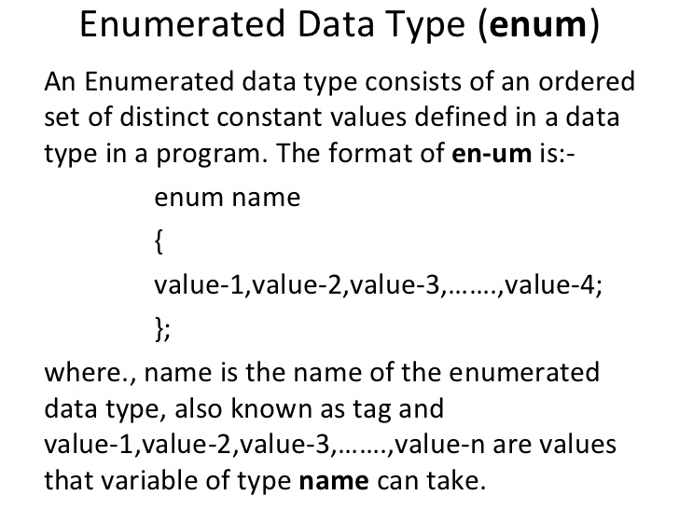

Slide 4
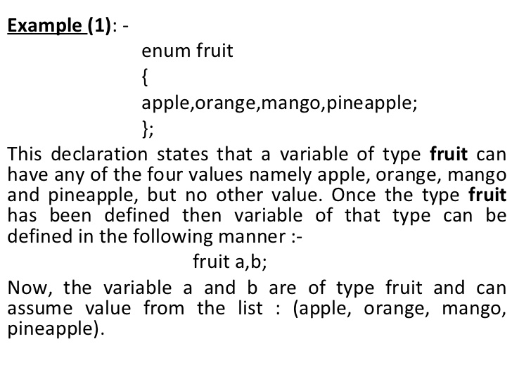
Enumerated Data Type

Slide 5
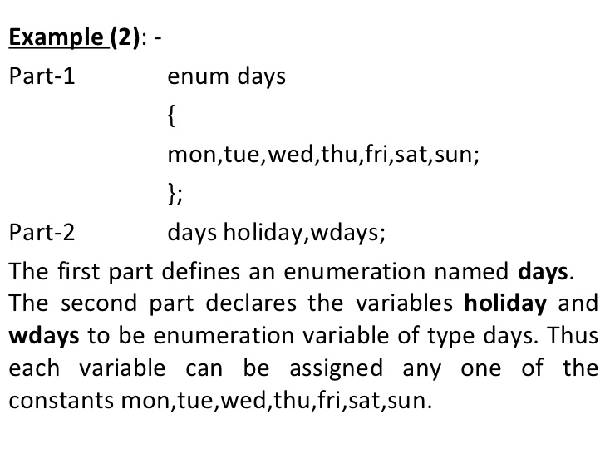
Enumerated Data Type

Slide 6
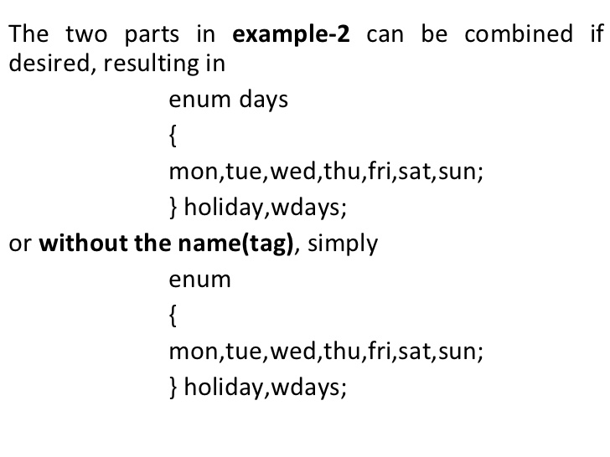
Enumerated Data Type

Slide 7
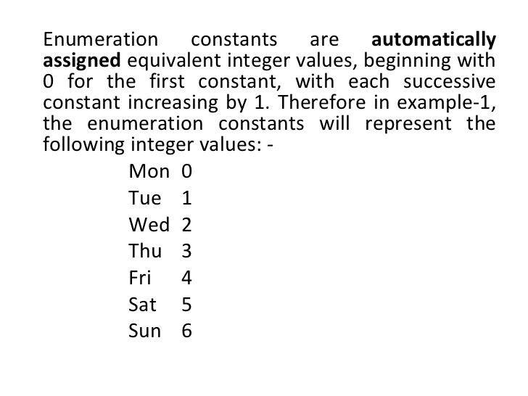
Enumerated Data Type

Slide 8
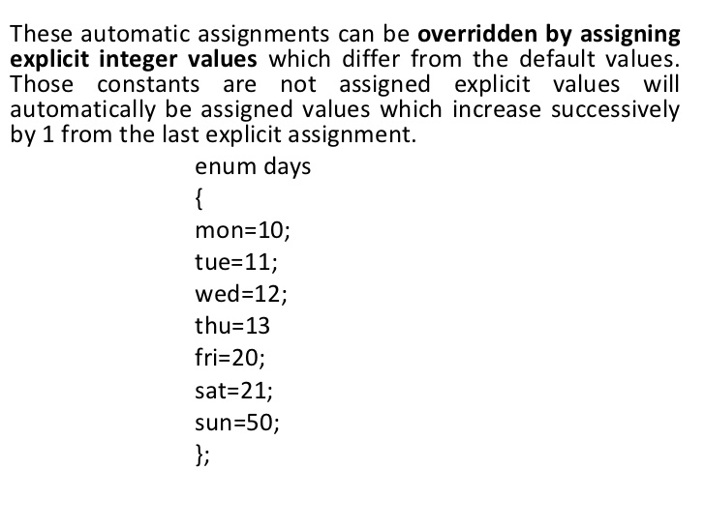
Enumerated Data Type

Slide 9
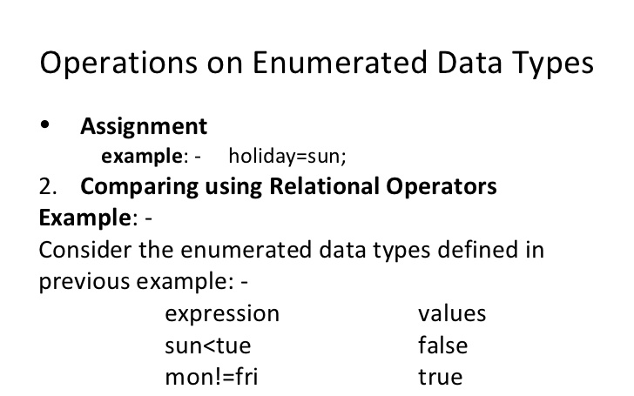

Slide 10
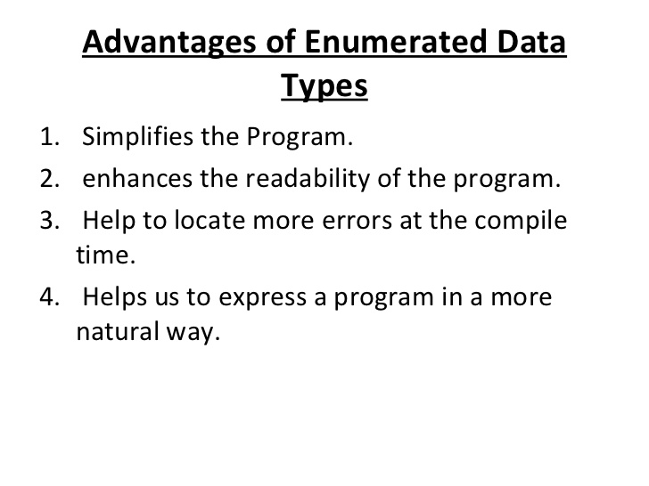

Slide 11
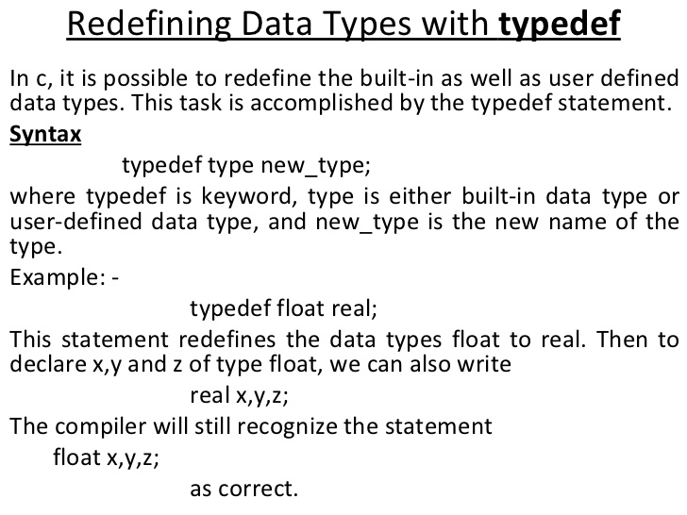
typedef

Slide 12
Structure
Structure is a way in which a complex user-defined data type can be created using simple types.
Is a derived data type like array, but unlike array can contain elements of various types.
For example, an employee is a data-type consisting of employee number, name and salary.
Structure allows us to define employee, and then assign variables to the employee structure type.

Slide 13
Syntax – Definition and Declaration
Defining structure:
struct struct-name{
data-type member-name1;
data-type member-name2;
…
data-type member-namen;
};
Declaring a variable of struct-type:
struct struct-name variable-name;
members

Slide 14
Example
Defining structure:
struct employee{
int emp_num;
char name[30];
double salary;
};
Declaring variable of struct-type:
struct employee emp1,emp2;

Slide 15
Accessing members
Structure members can be accessed using ‘ . ‘ (member access) operator on the structure variable.
Example:
emp1.emp_num, emp2.name
Structure members can be initialized during the declaration as:
struct employee emp={123,”Bobby”,345.50};

Slide 16
Example- simple (Employee Details)
struct emp{
int num;
char name[30];
double sal;
};
struct emp emps;
main(){
read();
display();
}
read(){
printf("enter emp number:");
scanf("%d",&emps.num);
printf("enter name:");
scanf("%s",emps.name);
printf("enter salary:");
scanf("%lf", &emps.sal); }
display(){
printf("Displaying data \n");
printf(" emp number: %d\n", emps.num);
printf(" emp name: %s\n",emps.name);
printf(" emp salary: %5.2lf\n",emps.sal);
}
Output:
enter emp number:123
enter name: xyz
enter salary:12340
Displaying data
emp number: 123
emp name: xyz
emp salary: 12340.00

Slide 17
Array of Structure
Array is a collection of elements of similar data types.
Structure is a collection of elements of different datatypes ( variables ) which are grouped together.
Array of structures is nothing but a collection of structures.
This is also called a structure array in C

Slide 18
Example – array of structure
main(){
struct ball{
int size;
char color[30];
};
struct ball b[3];
int i;
for(i=0;i<3;i++){
printf("enter size of the ball:");
scanf("%d",&b[i].size);
printf("enter the color:");
scanf("%s",b[i].color);
}
printf("Displaying data \n");
for(i=0;i<3;i++){
Array of Structure

Slide 19
printf(" ball size: %d\n",b[i].size);
printf(" ball color: %s\n",b[i].color);
}}
Output:
enter size of the ball:12
enter the color:green
enter size of the ball:13
enter the color:red
enter size of the ball:10
enter the color:yellow
Displaying data
ball size: 12
ball color: green
ball size: 13
ball color: red
ball size: 10
ball color: yellow
You enter this

Slide 20
Structure Pointers
A pointer variable can be declared that points to a structure as it points to an ordinary variable.
Example:
struct emp emps={123,"Ganga", 12000};
struct emp *e=&emps;
To access members through a structure pointer, a special kind of symbol → is used. (this symbol is just a dash and an angular bracket i.e. →)
Example:
e→num, e→name
Structure pointers are required when we pass a structure variable to a function and we want the changes made in the variable visible in the calling function.

Slide 21
struct emp{
int num;
char name[30];
double sal;
};
main(){
struct emp emps={123,"Ganga", 12000};
increment(&emps);
display(&emps);
}
increment(struct emp *e){
e->sal=e->sal*0.10+e->sal;
}
emps.num
emps.sal
123
Ganga
12000
2001
emps.name
13200
2001
e

Slide 22
display(struct emp *e){
printf("Displaying data \n");
printf(" emp number: %d\n",e->num);
printf(" emp name: %s\n",e->name);
printf(" emp salary: %5.2lf\n",e->sal);
}
Output:
Displaying data
emp number: 123
emp name: Ganga
emp salary: 13200.00

Slide 23
Nested structure (Structure within Structure
A structure can have as its member a structure variable.
Example:
struct name{
char fname[10];
char lname[10];
};
struct student{
struct name nm;
int rollno;
} stud;
Note: another way of declaring structure variable

Slide 24
main(){
printf("enter first and last name: ");
scanf("%s%s", stud.nm.fname,stud.nm.lname);
printf("\nenter roll number:");
scanf("%d", &stud.rollno);
printf("displaying data\n");
printf("Name:%s %s\n", stud.nm.fname,stud.nm.lname);
printf("roll no %d\n", stud.rollno);}
Output:
enter first and last name: John Ray
enter roll number:12345
displaying data
Name:John Ray
roll no 12345

Slide 25
Union: Syntax
Defining union:
union union-name{
data-type member-name1;
data-type member-name2;
…
data-type member-namen;
};
Declaring variable of union-type:
union union-name variable-name;
Accessing members:
variable-name.member_name

Slide 26
Unions
Union allows variables of different data types to share the same memory space.
C Compiler always reserve enough room for the largest member
For example, a variable of int type and a variable of type char share the same memory space. That means this memory space can be treated as int or char.
Union allows us to choose between types of data based on the requirement of the application.
It is the programmer's responsibility to see to it that only one logical data is stored and used in a memory

Slide 27
Difference between struct and union
struct X{
short a;
char c[2];
};
a
c[0]
c[1]
1000
1002
1003
1004
union X{
short a;
char c[2];
};
a
1000
c[0]
1001
c[1]
1002

Slide 28
main(){
union X{
short int a;
char c[2];
} x1;
x1.a=16449;
printf("%d\n",x1.a);
printf("%c\n",x1.c[0]);
printf("%c\n",x1.c[1]); }
//bin of(16449)= 01000000 01000001
Output:
16449
A
@
Output depends on the endianess of the system you are using
c[1]=ascii(64)=‘@’
a=16449
c[0]=ascii(65)=‘A’
0 1 0 0 0 0 0 0 0 1 0 0 0 0 0 1
Little endian
0 1 0 0 0 0 0 1
0 1 0 0 0 0 0 0
Big endian

Slide 29
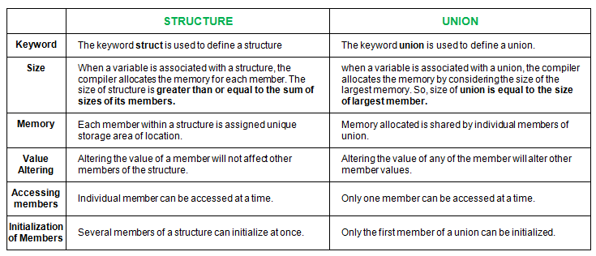
Difference between struct and union

